Slide 1
Battle of Neighborhoods: A comparison between NYC and Toronto
Presented by Yuhao Chen

Slide 2
NYC AND TORONTO
“Both the largest cities in their respective countries.
Both the financial and tourist capitals of their countries.
Both have a high cost of living.
Both have a network of subways, trains and buses serving their greater areas.
Both are known for their skyscrapers.
Both are extremely multi-ethnic.
Both are theatre capitals of the English-speaking world.”

Slide 3
Data
NYC and Toronto neighborhoods data
Foursquare API

Slide 4
Methodology
1. Importing Data and Data Preprocessing
2. Explanatory Data Analysis
3. Modelling

Slide 5
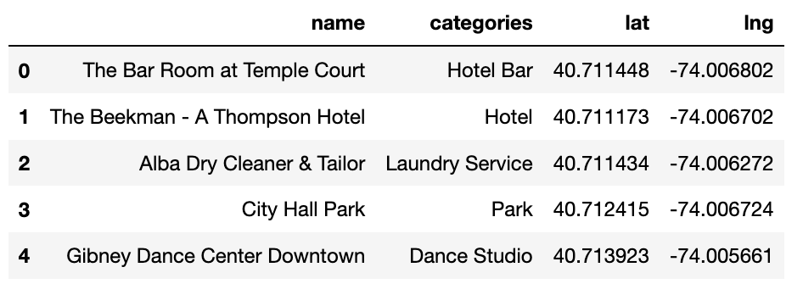
Data Preprocessing and EDA
After importin those libraries, we load geographic information of neighborhoods from nyc.csv and Toronto.csv, storing them in two different data frames (df, df2).
After reviewing our datasets, we start to import data from Foursquare API.
We begin our analysis by examining the categories of venues in both cities.

Slide 6
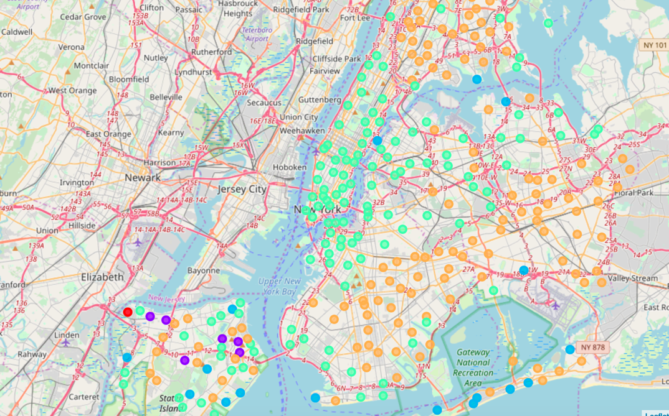
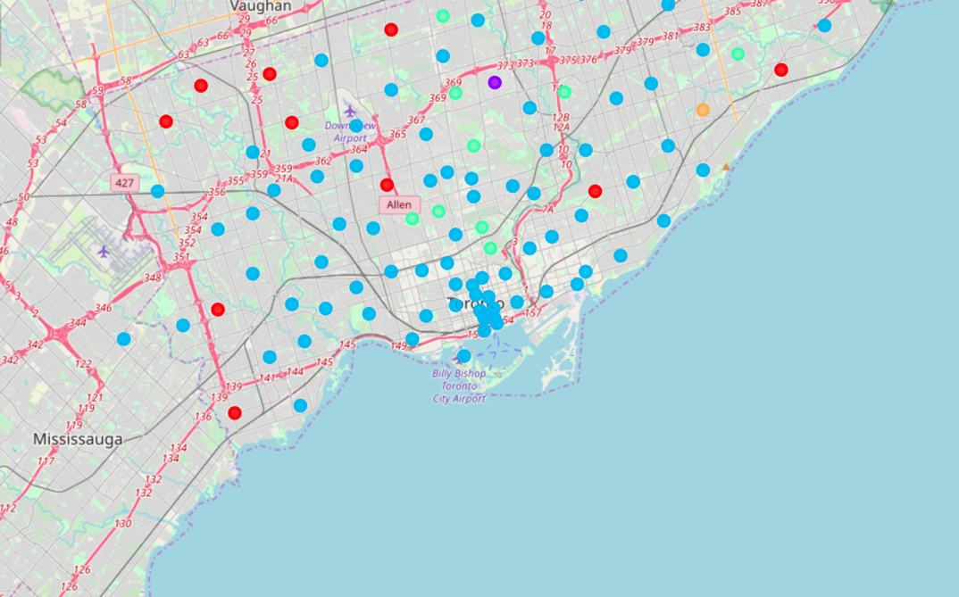
Clustering

Slide 7
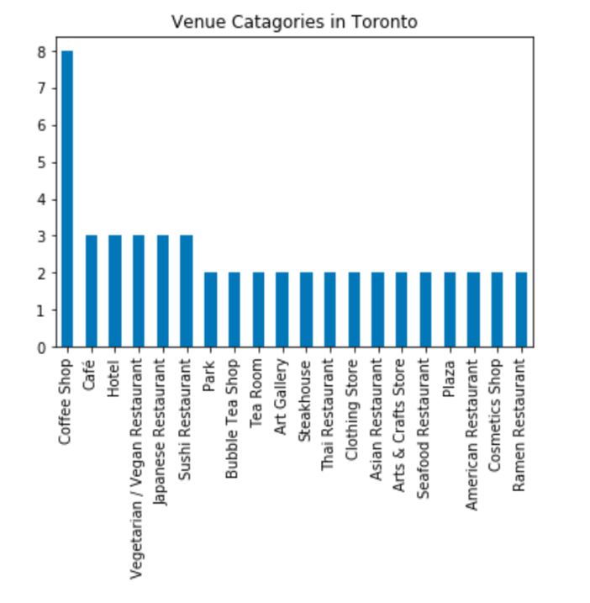
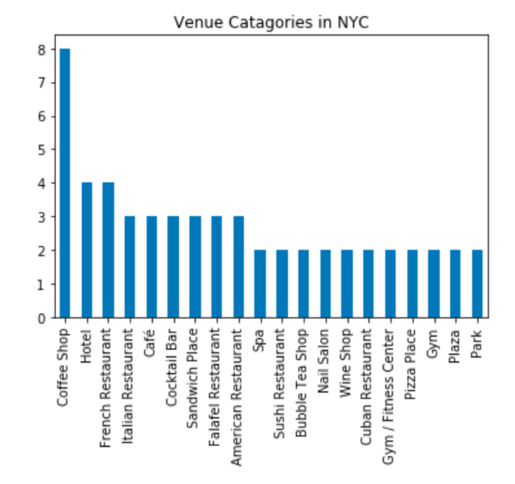
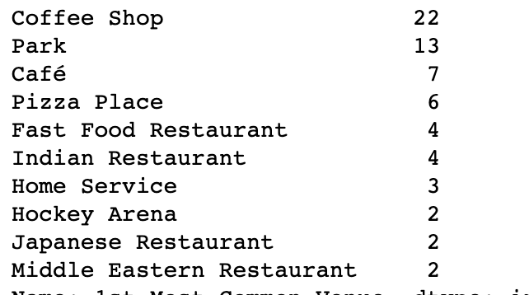
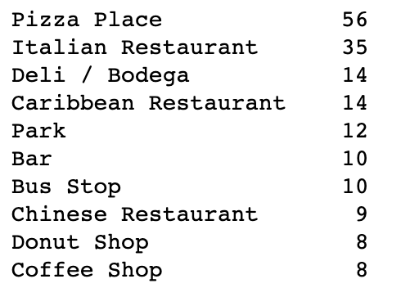
Result

Slide 8
Thank You

